Slide 1
420-D04-SU
Object-oriented programming I Java I
Swing 1

Slide 2
Swing
Graphical user interface (GUI)
There exist multiple libraries for GUI in Java.
AWT: java.awt (Java 1.0) heavyweight components
Swing: java.swing (Java 1.2) lightweight components
JavaFX: javafx
We will use Swing, although we will require some objects from the AWT library.
There are 2 types of fundamental elements:
Container
Component

Slide 3
First window
public class FirstWindow extends Jframe
{
public FirstWindow(String title)
{
super(title);
setDefaultCloseOperation(JFrame.EXIT_ON_CLOSE);
setSize(800, 600);
setLocationRelativeTo(null);
setVisible(true);
}
public static void main(String[] args)
{
FirstWindow window = new FirstWindow("Title");
}
}

Slide 4
Containers
Containers | JFrame | Window that can include taskbars, menu bars, and minimize/maximize/close buttons
 | JWindow | Simple window with no decoration (splash screen)
 | JPanel | Simple panel container
 | Applet | Applet (inherits from java.awt.Panel)

Slide 5
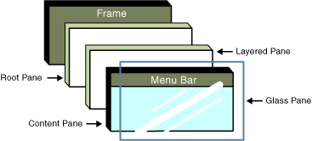
Containers: JFrame
A JFrame is composed of multiple superimposed layers.
Frame : the window
RootPane : the main container that contains the other components
LayeredPane : container with depth, with overlapping components according to their z-depth.
MenuBar : optional menu bar for our window
ContentPane : our workspace
GlassPane : layer used to intercept user actions before they reach the components

Slide 6
Containers: JPanel
JPanel is a container that can contain:
Other containers
Components
To add a JPanel to a JFrame, use this method:
setContentPane(Container contentPane)
To add a background color to a JPanel:
setBackground(Color.BLUE)
To access the main container:
getContentPane()

Slide 7
Containers: Layout
JPanel panel = new JPanel();
panel.setLayout(new FlowLayout());
setLayout() allows us to define how the child elements will be organized in the window.
The main layouts:
BorderLayout
FlowLayout
BoxLayout
GridLayout
GridBagLayout – not seen in course
MigLayout – not seen in course

Slide 8
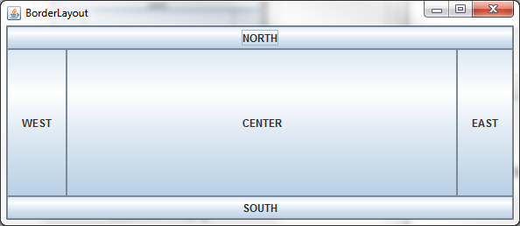
BorderLayout
The space is divided into 5 regions:
CENTER, NORTH, SOUTH, WEST, EAST
The components will take up all the space in the region they occupy.
The center predominates over the others.
Upon adding a component, you need to specify the region in which it will be placed.

Slide 9
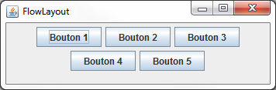
FlowLayout
The components are sized at their preferred size.
The components are placed in a horizontal row, one after the other.
These will collapse into multiple rows when horizontal space in the container is not sufficient to fit a single row.
You can modify the default alignment and padding behavior by using alternative FlowLayout constructors.

Slide 10
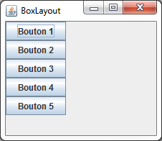

BoxLayout
Somewhat similar to FlowLayout, and can arrange the components either vertically or horizontally.
Unlike FlowLayout, the components will not wrap when the container is too small to fit them all in a line.
There is a Box class, which is a JPanel with the BoxLayout. You can use these static methods in Box to generate a Box instance with the right orientation.
Box b1 = Box.createHorizontalBox();
Box b2 = Box.createVerticalBox();

Slide 11
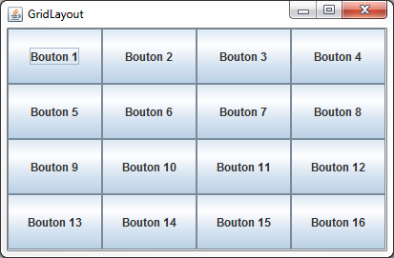
GridLayout
This layout allows us to define a grid with n rows and m columns, and (n × m) cells.
All of the cells have exactly the same dimensions.
Each component that is added takes up all of the space in its cell.

Slide 12
Default layout
JFrame, JWindow: BorderLayout
JPanel: FlowLayout
Apple: FlowLayout

Slide 13
Components
Components | JButton | Clickable elements that contain text or graphics.
 | JLabel | Text or graphics.
 | JTextField | Elements that allow users to enter and edit text.
 | JComboBox | Drop-down combo boxes containing a list of selectable elements. Combo boxes can either be uneditable or editable.
 | JCheckBox | Buttons that can be toggled from unchecked (false) to checked (true).
 | JRadioButton | Buttons similar to check boxes. Typically grouped together so that only one button in the group can be selected at a time.

Slide 14
Components
Procedure to follow:
Create the component
Configure the component
Add the component to its container

Slide 15
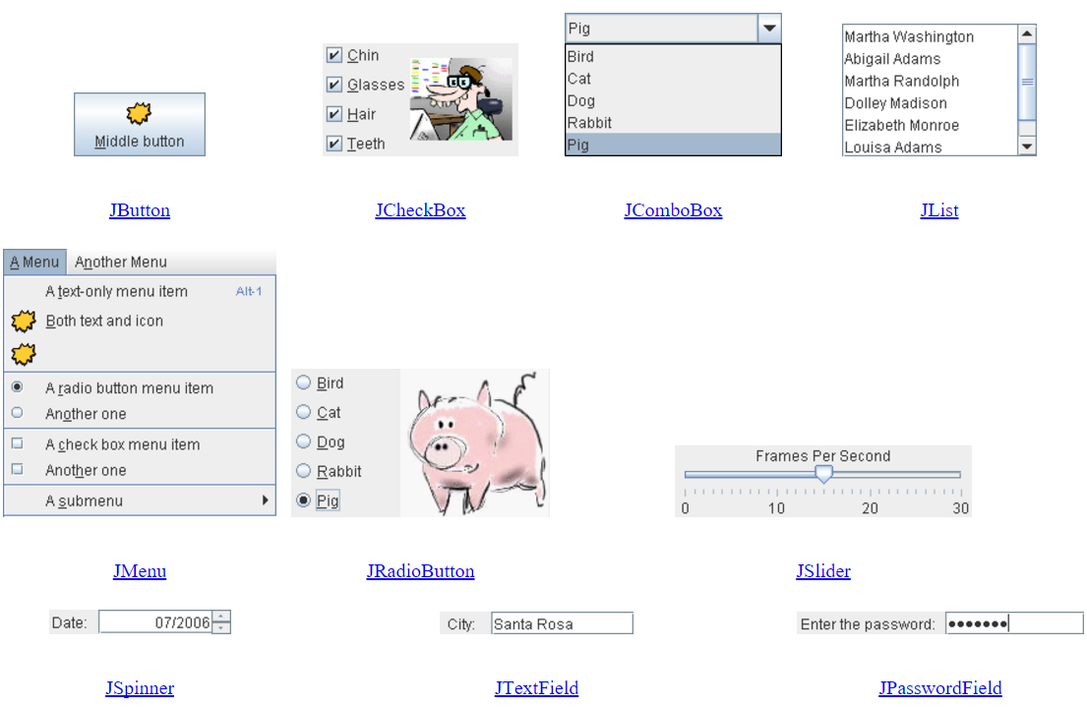
Basic components

Slide 16
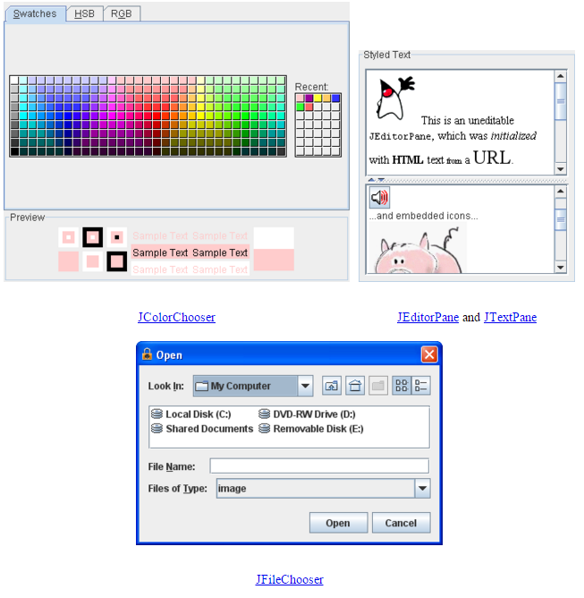
Interactive and formatted components

Slide 17
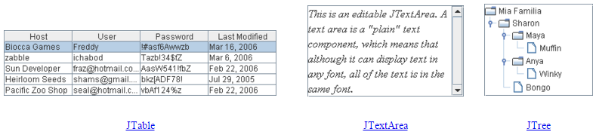
Interactive and formatted components

Slide 18
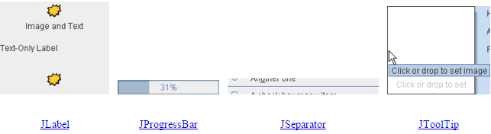
Uneditable components

Slide 19
The Graphics object
Cannot be used unless the system gives us access via a component’s getGraphics() method.
Method call for drawing on our window and components.
Permits customizing components or containers via the method:
public void paintComponent(Graphique g)
You should never call this method, because it is invoked automatically if:
the window is resized, or
the repaint() method is called

Slide 20
Drawing a square in a JPanel
class MyPanel extends JPanel
{
@Override
protected void paintComponent(Graphics g)
{
g.setColor(Color.RED);
g.fillRect(200, 200, 50, 50);
}
}

